Slide 1

Rideshare Price Prediction in Boston using Machine Learning
CIS 508: Final Project
Meshach Samuel

Slide 2
Business Problem & Stakeholders
Business Context
Rideshare prices fluctuate with distance, demand and weather, which makes it hard for riders to anticipate cost
Stakeholders
Riders (Plan Trips, Compare Prices)
Drivers (Understand when Trips are More Profitable
Platform (Pricing Transparency)
ML Task
Target = Price
Supervised Regression
Given a Rider’s Pickup Details, Can we Predict the Ride Price?

Slide 3
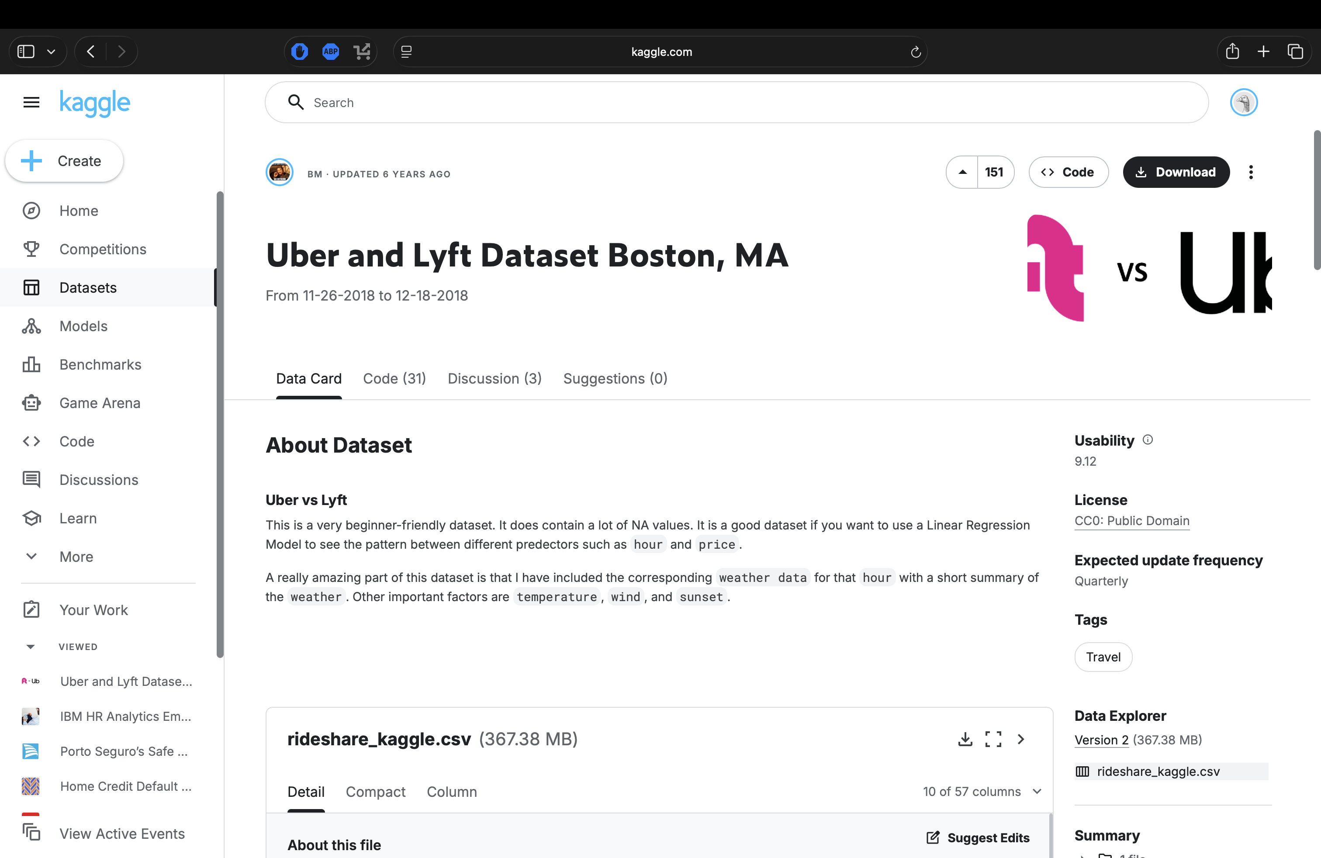
Dataset Overview
Source: Kaggle “Uber and Lyft Dataset Boston, MA”
693071 Rows, 57 Columns
Target: price
Key Features: hour, day, month, distance, name, cab_type, source, destination, etc.
https://www.kaggle.com/datasets/brllrb/uber-and-lyft-dataset-boston-ma

Slide 4
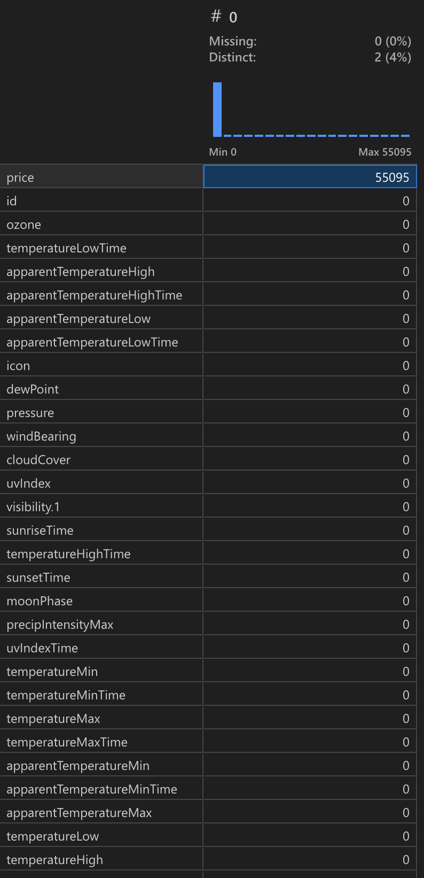
Data Quality and Checks
Loaded Data with Pandas and inspected Summary Statistics
Missing Values – 55K
Duplicate Rows - None
Removed Unnecessary Columns: id, icon, timezone, etc.
Removed Outliers
Only Price Column had Null Values
55K Rows with Null Values from 690K Rows. 55/690 = < 8% Easiest to Remove All Rows with Null Values

Slide 5
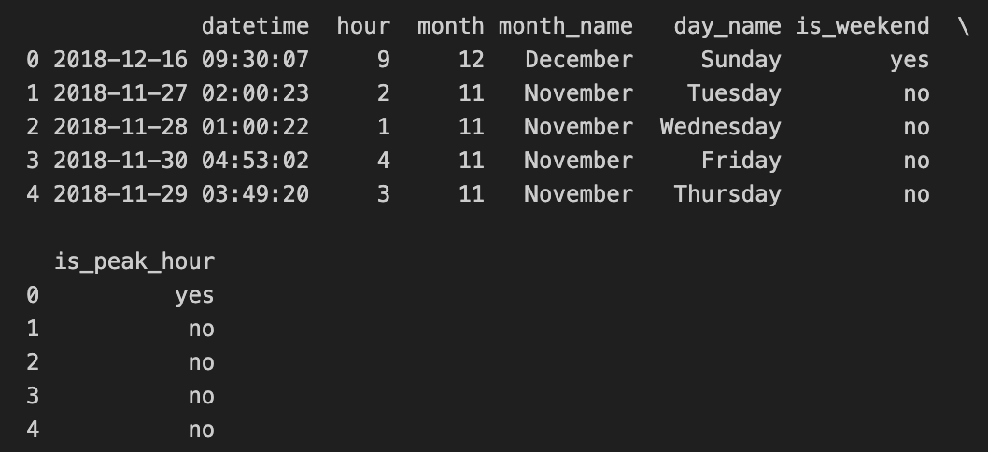
Feature Engineering
Used Provided hour, day, month Columns
Derived Descriptive Time Features:
day_name (Monday-Sunday)
month_name
is_weekend flag
is_peak_hours flag

Slide 6
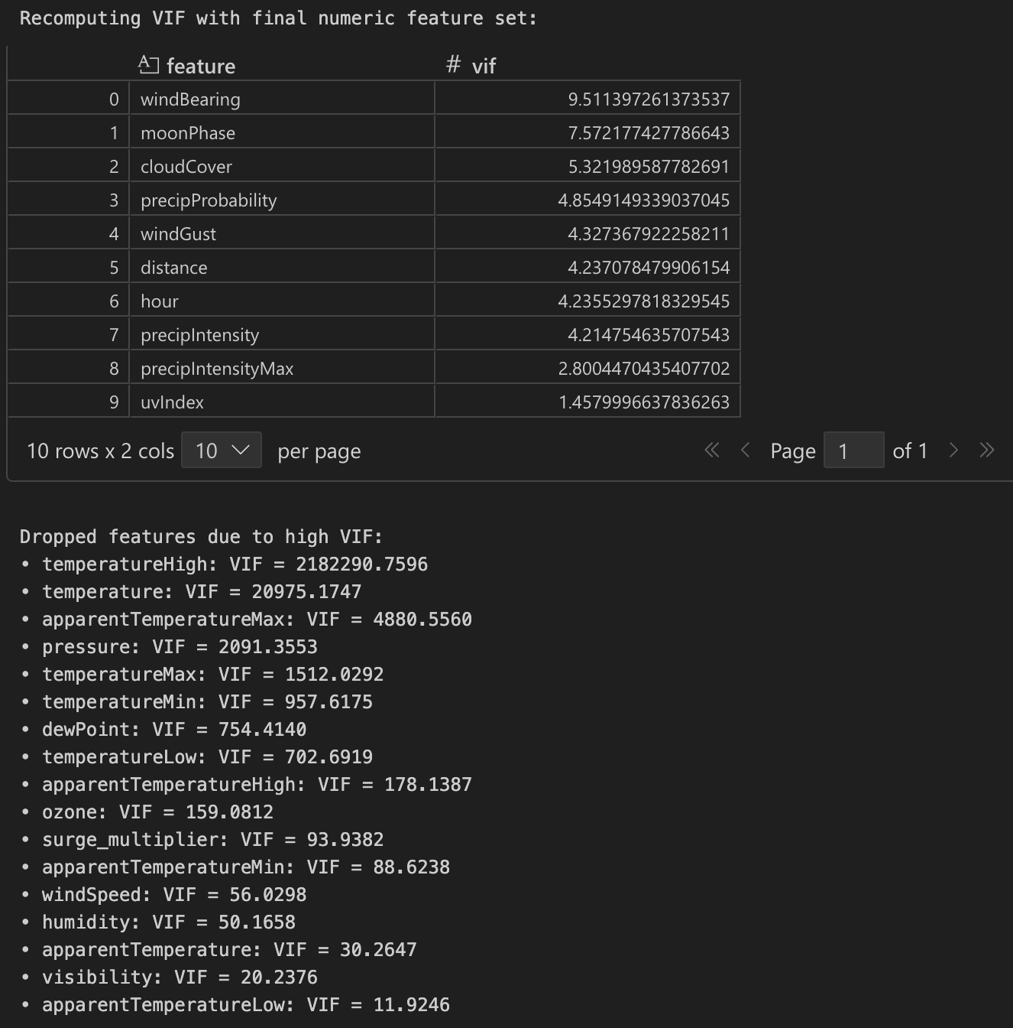
Feature Selection
VIF Analysis:
Used Variance Inflation Factor (VIF) to Identify Highly Collinear Numeric Columns
Dropped Numeric Columns with very High Correlation: VIF>10

Slide 7
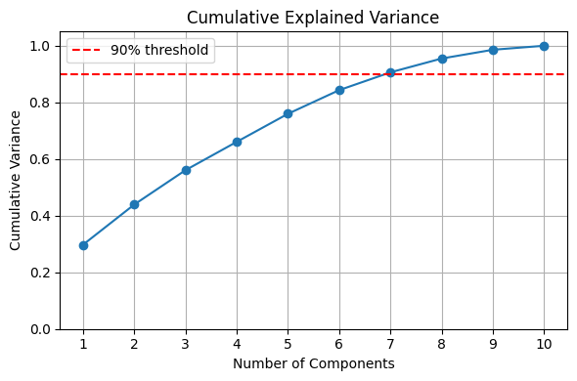
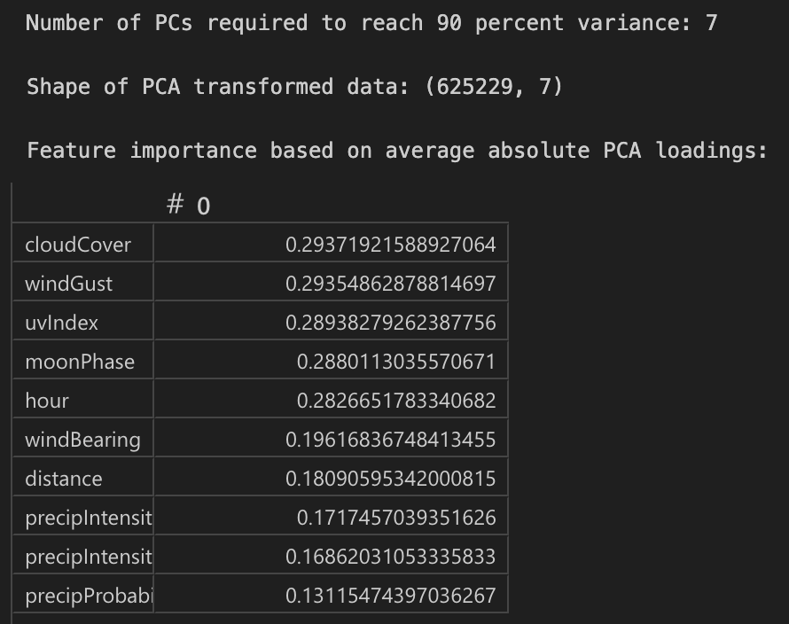
Feature Selection
PCA Analysis:
Performed PCA on standardized numeric columns to understand feature redundancy
First few components captured most of the variance
Dropped Columns after exceeding 90% Variance

Slide 8
Final Feature Selection List
Numeric List:
hour
distance
precipIntensity
windGust
windBearing
cloudCover
uvIndex
moonPhase
precipIntensityMax
Categorical List:
cab_type
name
source
destination
short_summary
day_name
month_name
is_weekend
is_peak_hour

Slide 9
Modelling Pipeline
Input: Full feature matrix with numeric and categorical columns
Pre-Processing:
Numeric Pipeline: StandardScaler for All Numeric Columns
Categorical Pipeline: OneHotEncoder
Each Model wrapped in a Pipeline with the Pre-Processor
Train-Test Split: 80-20 Split with Random State

Slide 10
Models: Algorithms and Tuning
Models Trained:
Linear Regression
Decision Tree Regressor
Random Forest Regressor
XGBoost Regressor
KNN Regressor
Linear SVM
Neural Network
Ensemble Model - Gradient Boosting
Hyper-Parameter Tuning
Used GridSearchCV
Each Model had 3 Parameters with 2 Options
Scoring Metric
RMSE (Root Mean Squared Error)

Slide 11
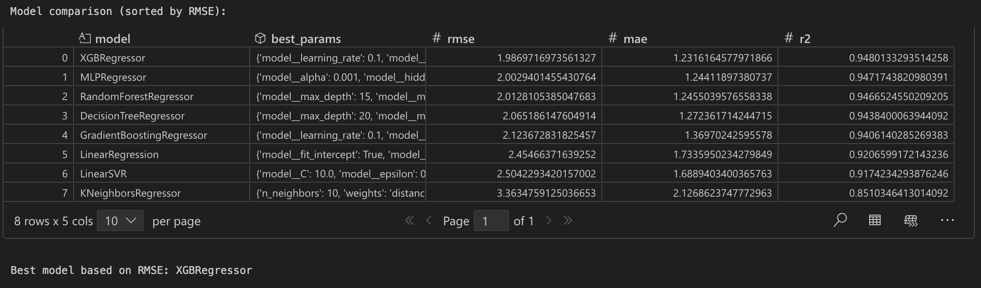
Model Comparison

Slide 12
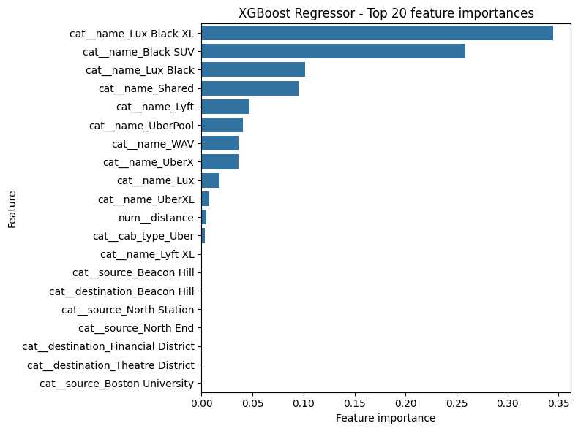
Feature Importance
Majority of the Important Features are Cab Type
Distance is also an Important Feature
Origin and Destination of Ride are also Important Features

Slide 13
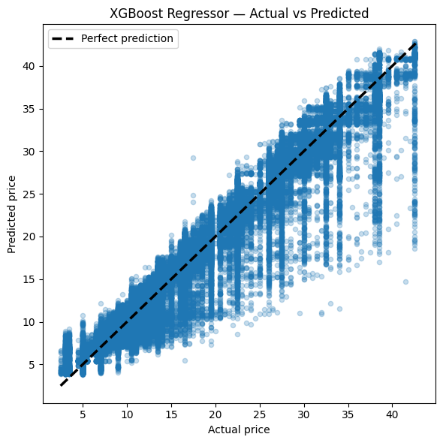
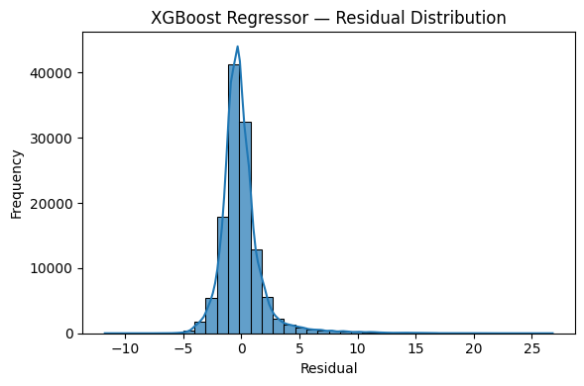
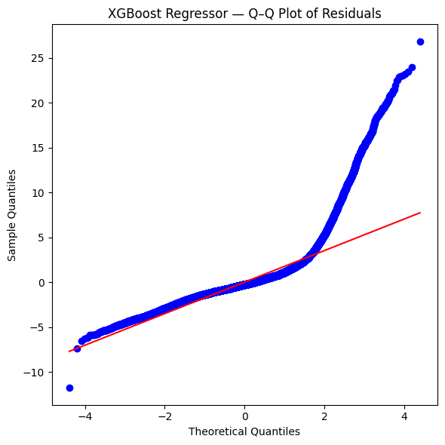
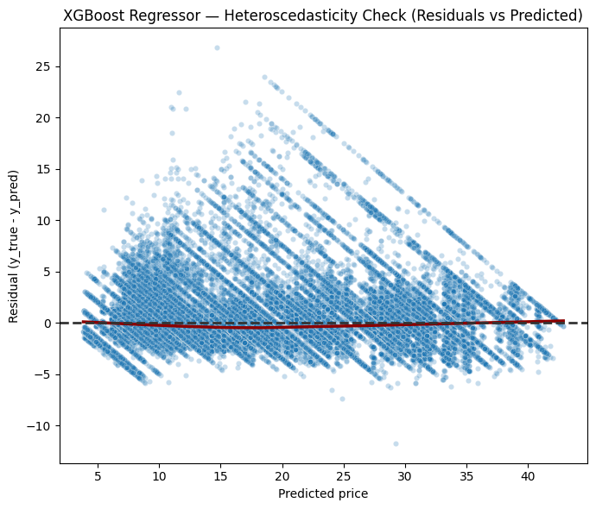
Error Analysis
Predictions closely follow the perfect fit line, with larger spread on higher priced rides
Residuals center around zero with a slight positive tail showing occasional underprediction
Residuals match normality in the middle but deviate in the upper tail, confirming heavier positive errors
Residual variance increases with predicted price, indicating mild heteroscedasticity

Slide 14
Model Deployment
https://meshachsamuel-cis508-finalproject.streamlit.app

Slide 15
Limitations and Future Improvements
Limitations:
Data:
Single City (Boston) and Short Period
No Traffic or Real Time Data
Modeling:
Pure Supervised Regression. No Time Series Structure
No Analysis by Neighbourhood
Improvements:
Integrate Additional Features:
Real Time Demand
Traffic Conditions
Calendar Events
Extend to Multiple Cities and Compare Pricing Patterns across Cities and Locations

Slide 16
Links
GitHub: https://github.com/ProntoSbinalla/CIS-508-Final-Project
DataBricks: https://dbc-c0894453-af7b.cloud.databricks.com/ml/experiments/927873117134361/runs?o=3434810423377078&searchFilter=&orderByKey=attributes.start_time&orderByAsc=false&startTime=ALL&lifecycleFilter=Active&modelVersionFilter=All+Runs&datasetsFilter=W10%3D
StreamLit App: https://meshachsamuel-cis508-finalproject.streamlit.app

